Slide 1
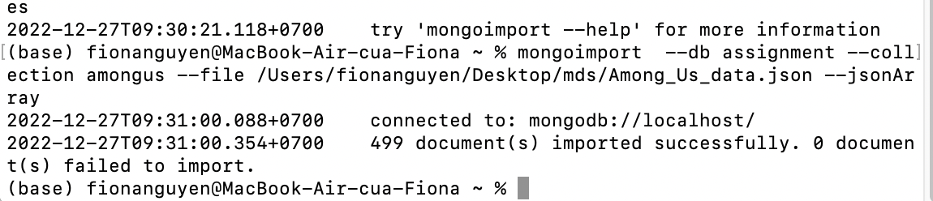
Question No: 1.a
Read in the data using the mongoimport command. mongoimport --db assignment --collection amongus --file /Users/fionanguyen/Desktop/mds/Among_Us_data.json --jsonArray
<Attach a screenshot of the output here>

Slide 2
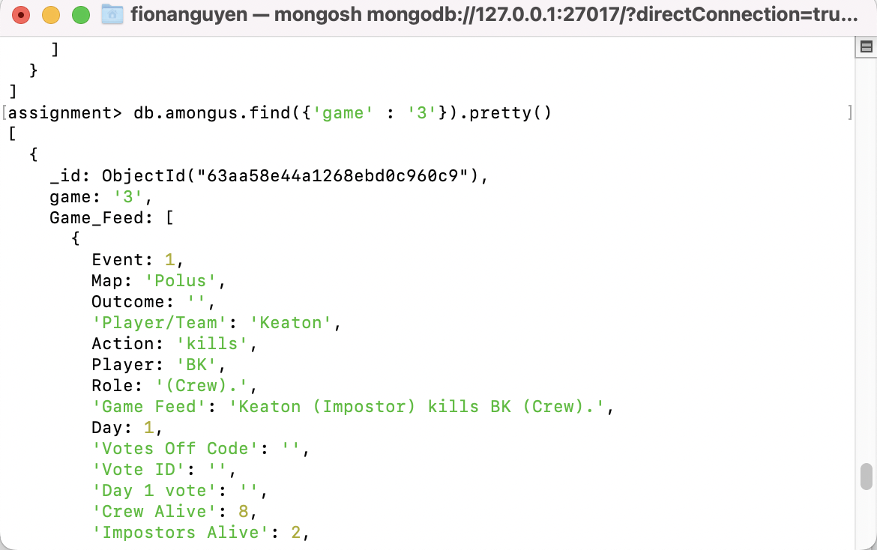
Question No: 1.b
FDisplay data for the match with “game” = “3” - db.amongus.find({'game' : '3'}).pretty()
<Attach a screenshot of the output here>

Slide 3
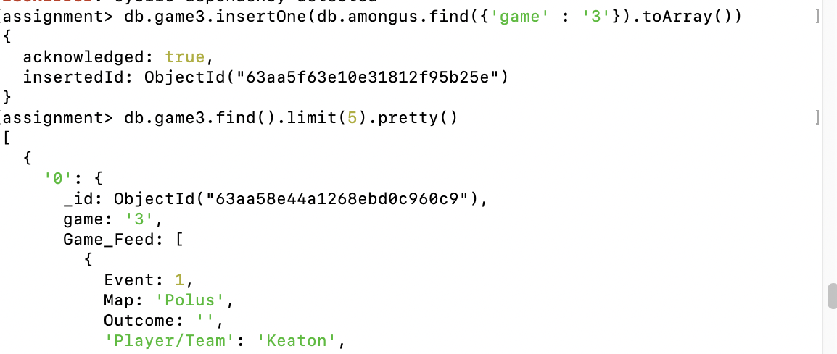
Question No: 2
In this subtask, you are expected to create a new collection with only the document relating to game 3-
db.game3.insertOne(db.amongus.find({'game' : '3'}).toArray())
<Attach a screenshot of the output here>

Slide 4
Question No: 2.1
Display the Game Feed data for the game in the new collection-
db.game3.find().limit(5).pretty()
Answer the question in brief points and add suitatable data to support your answer (wherever applicable).

Slide 5
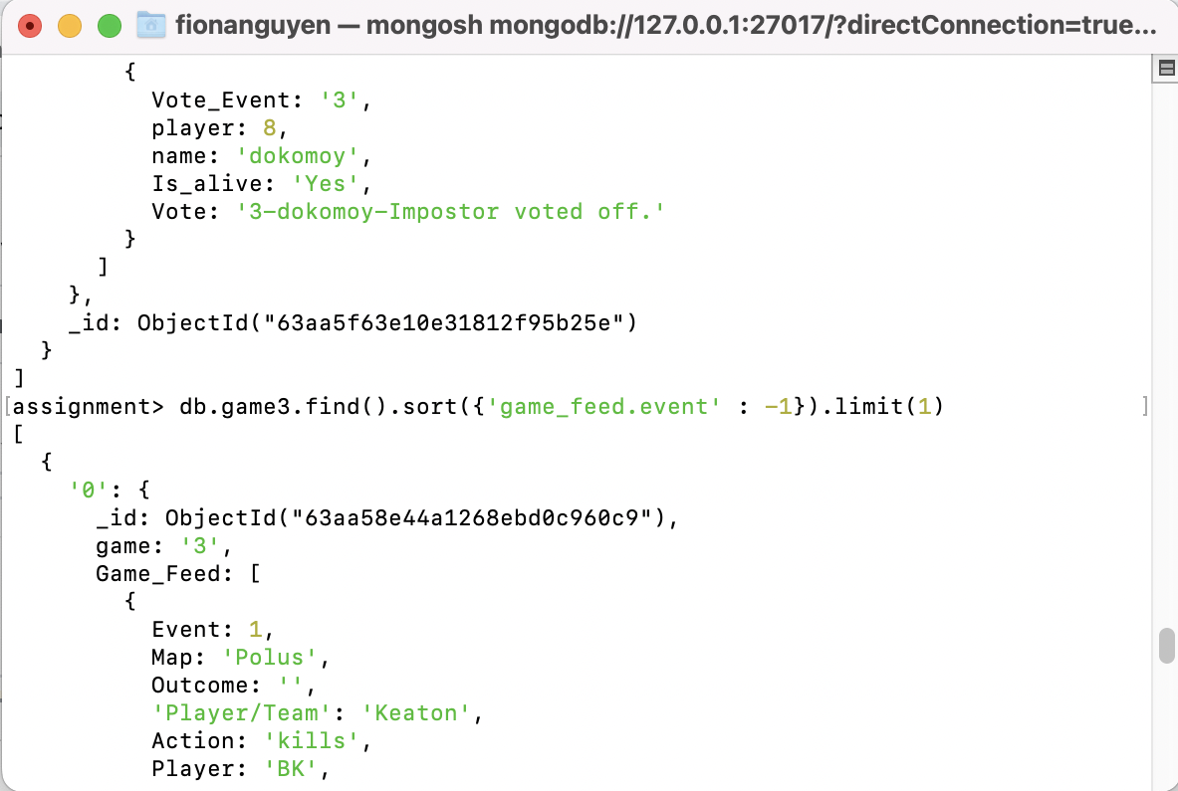
Question No: 2.2
Display the last event in game 3-
db.game3.find().sort({'game_feed.event' : -1}).limit(1)
Answer the question in brief points and add suitatable data to support your answer (wherever applicable).

Slide 6
Question No: 2.3
Who won game 3, imposters or crew?-
Answer the question in brief points and add suitatable data to support your answer (wherever applicable).

Slide 7
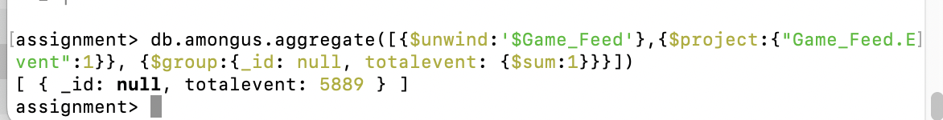
Question No: 3.1
How many events in total do you have data for, in this collection (across all games)?-
db.amongus.aggregate([{$unwind:'$Game_Feed'},{$project:{"Game_Feed.Event":1}}, {$group:{_id: null, totalevent: {$sum:1}}}])
Answer the question in brief points and add suitatable data to support your answer (wherever applicable).

Slide 8
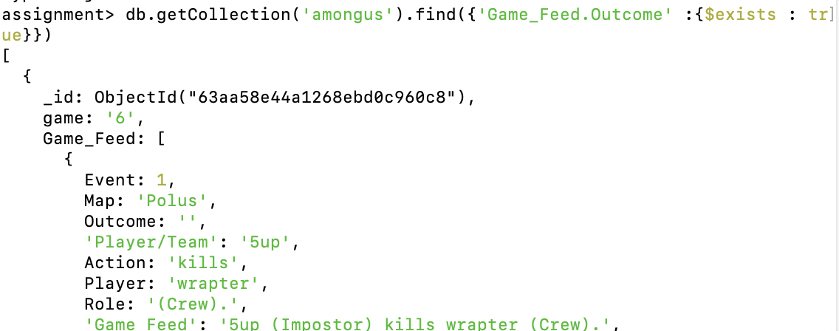
Question No: 3.2
How many matches did the crew win versus how many matches did the impostors win?-
Total event end: db.getCollection('amongus').find({'Game_Feed.Outcome' :{$exists : true}})
Answer the question in brief points and add suitatable data to support your answer (wherever applicable).

Slide 9
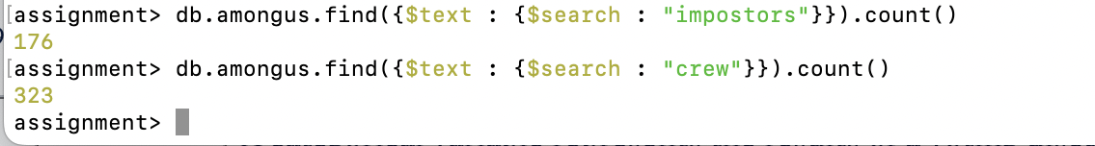
Question No: 3.2
How many matches did the crew win versus how many matches did the impostors win?-
db.amongus.find({$text : {$search : "impostors"}}).count() - Impostors win - 176 matches
db.amongus.find({$text : {$search : "crew"}}).count() - crew win - 323 matches
Answer the question in brief points and add suitatable data to support your answer (wherever applicable).

Slide 10
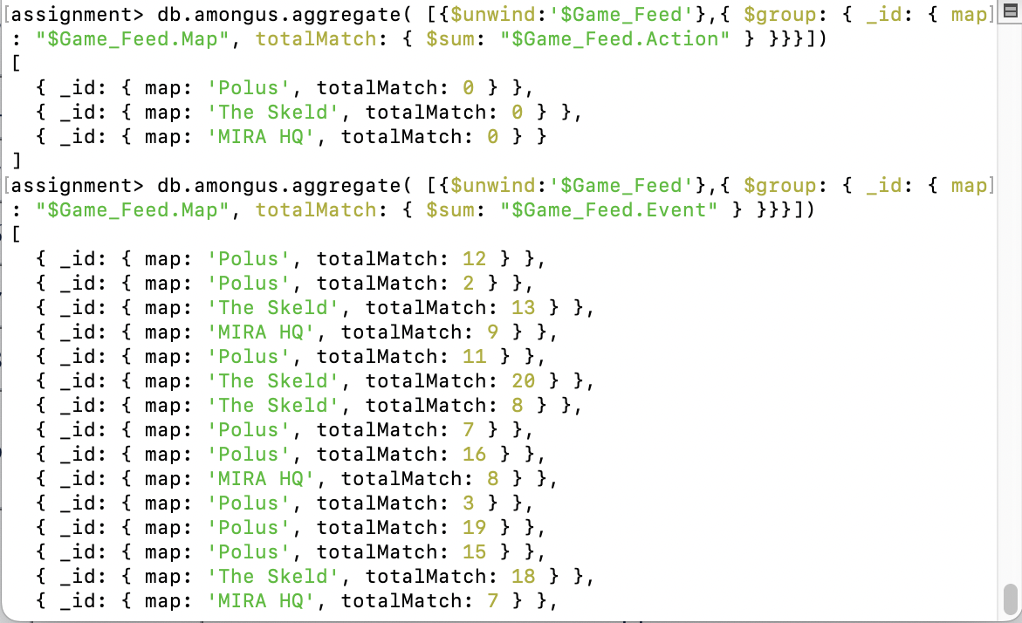
Question No: 3.3
Find out how many matches were played on each map. Your output should contain the names of maps and the number of games played on each map. -
db.amongus.aggregate( [{$unwind:'$Game_Feed'},{ $group: { _id: { map: "$Game_Feed.Map", totalMatch: { $sum: "$Game_Feed.Event" } }}}])
db.amongus.aggregate( [{$unwind:'$Game_Feed'},{ $group: { _id: { map: "$Game_Feed.Map", totalMatch: { $sum: "$Game_Feed.Action" } }}}])
Answer the question in brief points and add suitatable data to support your answer (wherever applicable).

Slide 11

Question No: 3.4
How many times in total across all games did the crew skip a vote? -
db.amongus.aggregate({$unwind : '$Game_Feed'}, {$match : {$and: [{'Game_Feed.Role' : '(Crew).'}, {'Game_Feed.Action' : 'skips voting.'}]}}, {$group:{_id:null, totalskip: {$sum : '$Game_Feed.Action'}}})
assignment> db.amongus.createIndex({'voting_data.Vote' : "text"})
assignment> db.amongus.find({$text : {$search : "skipped"}}).count() - 385
Answer the question in brief points and add suitatable data to support your answer (wherever applicable).

Slide 12
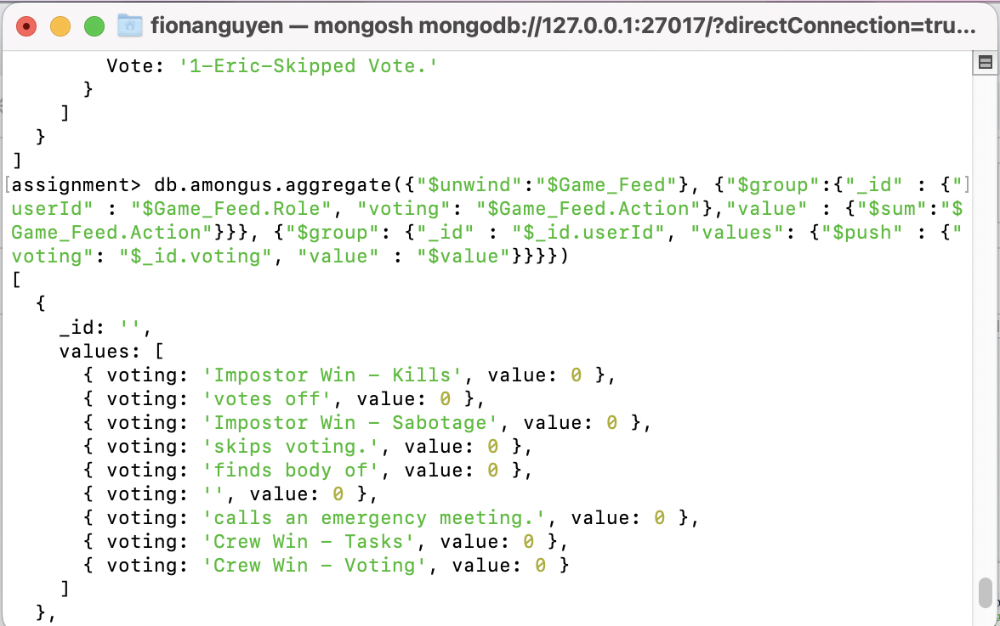
Question No: 3.2
How many times in total across all matches does the crew vote against imposters??-
db.amongus.aggregate({"$unwind":"$Game_Feed"}, {"$group":{"_id" : {"userId" : "$Game_Feed.Role", "voting": "$Game_Feed.Action"},"value" : {"$sum":"$Game_Feed.Action"}}}, {"$group": {"_id" : "$_id.userId", "values": {"$push" : {"voting": "$_id.voting", "value" : "$value"}}}})
Honestly, I don't play this game, therefore, there're many question I cannot get to the point.

Slide 13
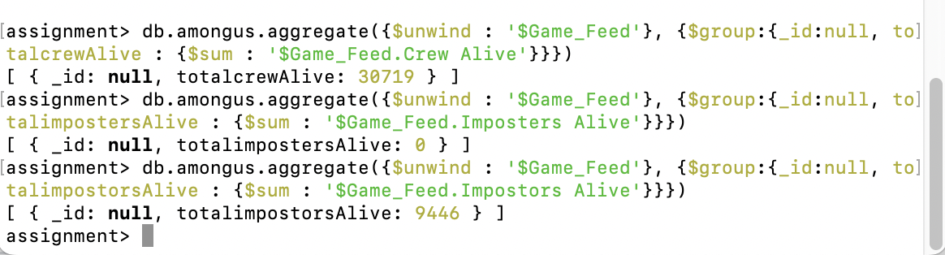
Question No: 3.6
The questions you answered in this task were all related to high-level aggregations across the entire collection. In your opinion, is the game more or less hard for impostors??-
db.amongus.aggregate({$unwind : '$Game_Feed'}, {$group:{_id:null, totalcrewAlive : {$sum : '$Game_Feed.Crew Alive'}}})
db.amongus.aggregate({$unwind : '$Game_Feed'}, {$group:{_id:null, totalimpostorsAlive : {$sum : '$Game_Feed.Impostors Alive'}}})
Crew alive: 30719
Impostors alive: 9446
=> This game is more hard for impostors due to the live ratio of the crew is nearly 4.7 times of impostors.
Honestly, I don't play this game, therefore, there're many question I cannot get to the point.

Slide 14
Question No: 3.2
How many times in total across all matches does the crew vote against imposters??-
db.amongus.find({$text : {$search : "impostors"}}).count() - Impostors - 176
db.amongus.find({$text : {$search : "crew"}}).count() - crew - 323
Honestly, I don't play this game, therefore, there're many question I cannot get to the point.

Slide 15
Question No: 4.1
Find the number of unique players in the data set.-
db.amongus.aggregate([{$unwind: "$player_data"}, {$unwind: "$player_data.player"}, {$group:{_id: "$player_data.player"}}])
Answer the question in brief points and add suitatable data to support your answer (wherever applicable).

Slide 16
Question No: 3.2
How many matches did the crew win versus how many matches did the impostors win?-
db.amongus.find({$text : {$search : "impostors"}}).count() - Impostors - 176
db.amongus.find({$text : {$search : "crew"}}).count() - crew - 323
Answer the question in brief points and add suitatable data to support your answer (wherever applicable).

